Slide 1
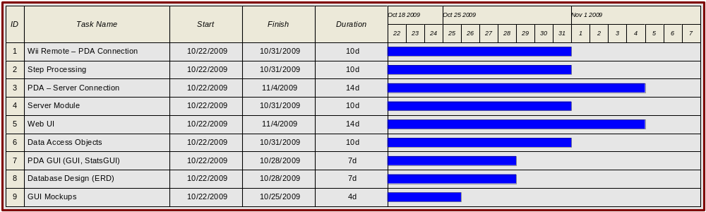

Slide 2
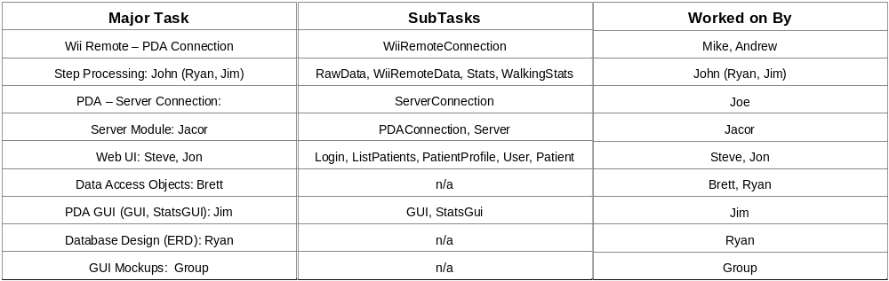

Slide 3
Unit Test Plan
Unique Test Identifier
  Initials of the Object
  Subscript Initials of the Method
Risk Analysis
  What are the risks associated with implementing this method.
    Is the method possible?
    Consequences if incorrectly implemented.
Possible Defects
  What are the flaws to watch for.
Completion Criteria
  When will this method be considered complete.
    Specification of inputs, and what the output should look like.
    What other operations must the method perform.

